Slide 1
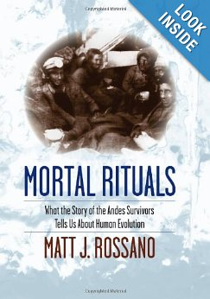
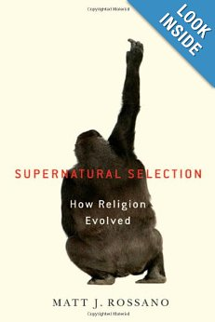
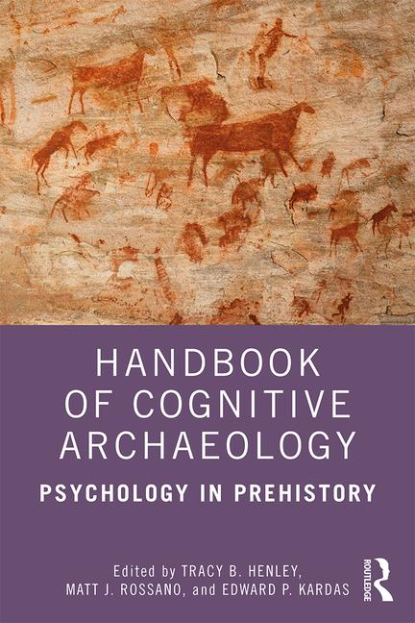
How Ritual Made Us Human
Major Sources:
Rossano, M.J. (2013) Mortal rituals: What the story of the Andes survivors tells us about human evolution. New York: Columbia University Press.
Rossano, M.J. (2010). Supernatural selection: How religion evolved. New York: Oxford University Press.
Rossano, M.J. (2012). The essential role of ritual in the transmission and reinforcement of social norms. Psychological Bulletin, 138, 529-549.
Rossano, M. J. (2015). The evolutionary emergence of costly rituals. PaleoAnthropology, 2015, 78-100.
Rossano, M. J. (2019). How ritual made us human. In T. B. Henley, M. J. Rossano, & E. P. Kardas (eds.), Handbook of cognitive archaeology: Psychology in pre-history. London: Routledge.

Slide 2
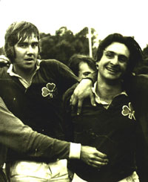
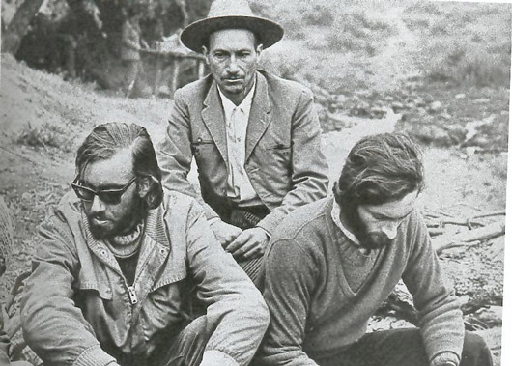
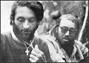
Ritual Saves Lives
Fernando “Nando” Parrado
Roberto Canessa
Sergio Catalan

Slide 3
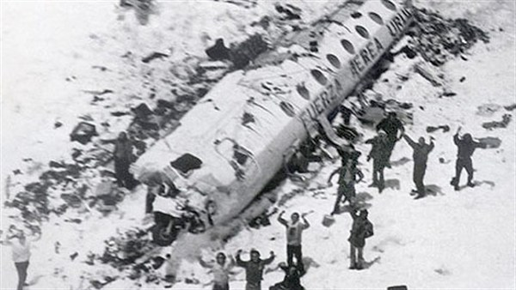
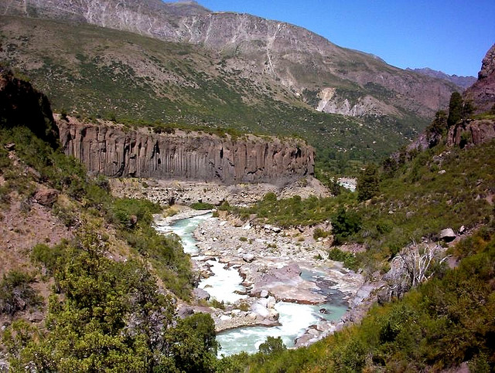
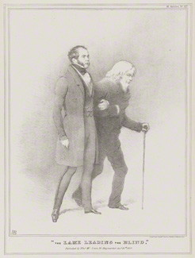
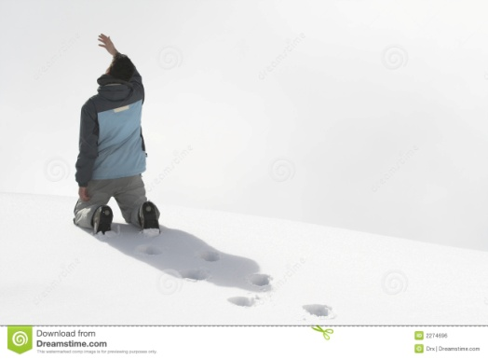
The ritual plea

Slide 4
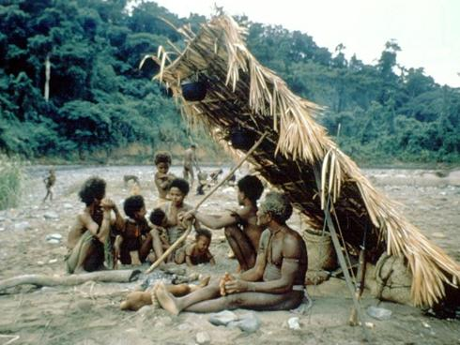
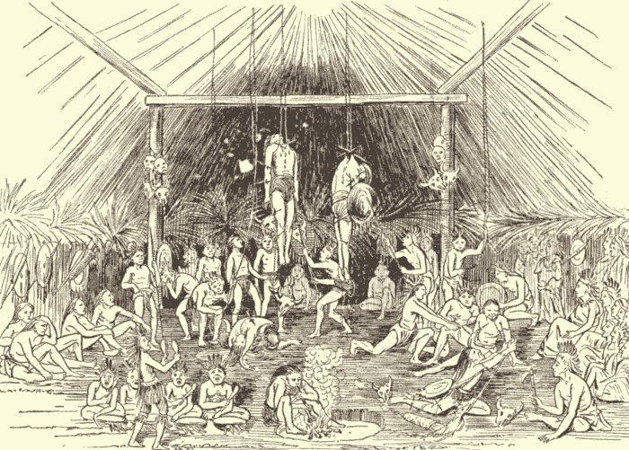
The argument
1. Humanity defined by cooperative communities
2. Community defined (costly) ritually ensured trust
Corollary: religious ritual especially powerful due to ‘cost.’
3. Ritual sustains humanity/ elevates humanity

Slide 5
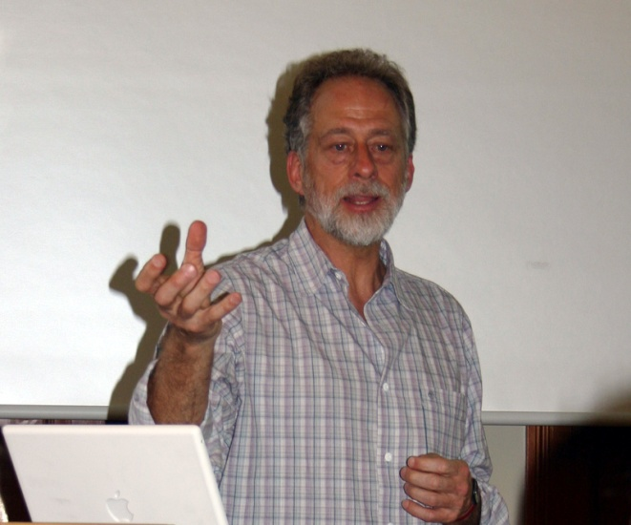

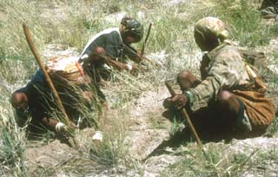
Argument 1: Humanity defined by cooperative communities Michael Tomasello: Humans as the ‘ultra social’ animal
Past approaches to defining ‘humanity’ have focused on human rationality. These attempts have failed largely due to the problem of arbitrariness. No rational trait is uniquely associated with (all) humans. Differences in degree. Where to draw the line?
Language?
TOM?
Abstraction?
Episodic memory?
Symbolism?
Analogical reasoning?
Two step processes to ultra-sociality:
Obligate cooperative foraging. Created intrinsic motivation to cooperate (cooperative mind)
Group competition: Created strong commitment to group and its cultural norms (tribal mind)

Slide 6
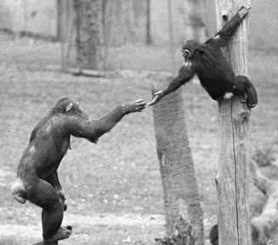
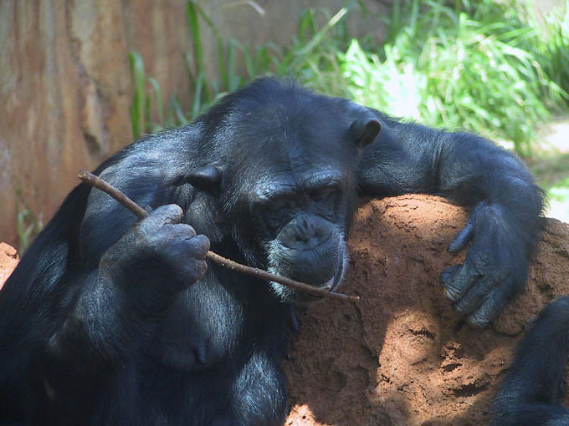
Primate Cooperation
Humans are primates and primates are social, but their sociality co-exists with strong intra- and inter-group competition.
Among our closest relatives (chimpanzees and bonobos) foraging is largely solitary, in sharp contrast to humans where foraging is highly cooperative.

Slide 7
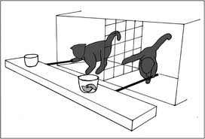
Primate Cooperativeness
Chimpanzee cooperativeness limited by dominance:
Researchers had children and chimps work together pulling on ropes to bring into reach a food reward.
When reward was pre-divided into two equal piles chimps and children both cooperated effectively.
When reward was in single pile chimp cooperation broke down. Why? Dominant chimp took all. Kids, by contrast, fairly easily divided reward equally.

Slide 8
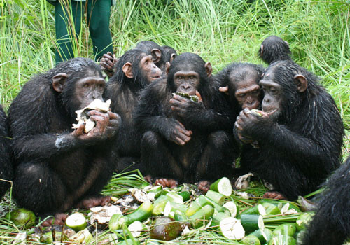
Effort-reward justice
A concept that evolved over the course of human evolution.
In another study where a second kid or chimp could help out or not in retrieving a reward, kids excluded a non-participant from getting part of the reward, whereas chimps did not.
For chimps critical variable was simply proximity. Whether he/she had helped or not, if chimp close by, chimp got some of the reward.

Slide 9
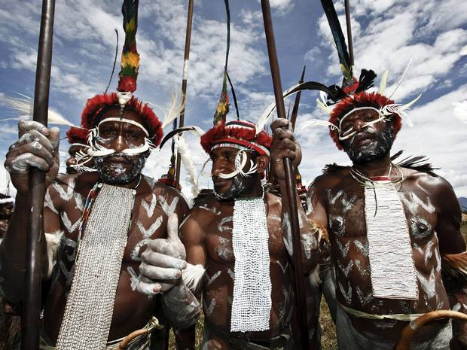
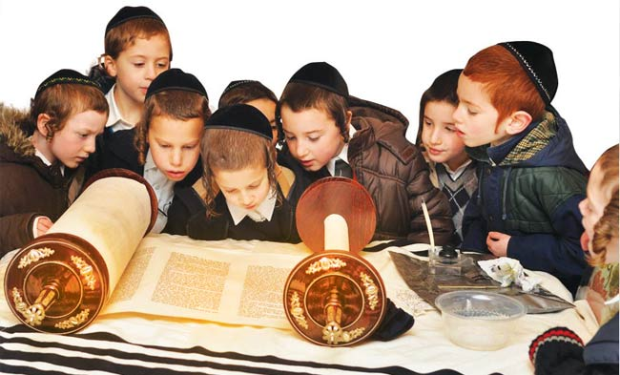
Group competition: How to ensure trust?
Selected for tribal minds = group>self
So can one be sure another puts the tribe before self?
Ans: Ritual displays of commitment to group norms.
Argument 2: Community defined by ritually-ensured trust.

Slide 10
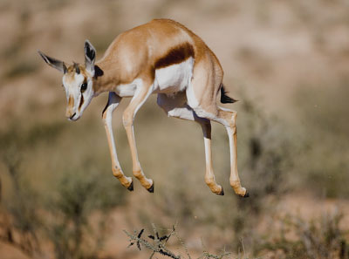


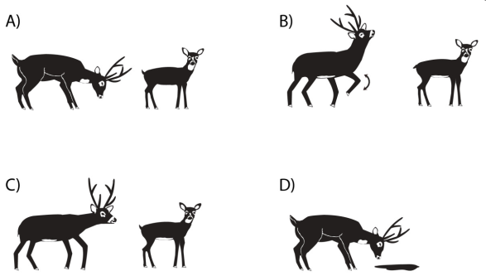
Ritualized behavior: Deep evolutionary roots
Ritual is widespread in the animal kingdom where effective communication is required

Slide 11
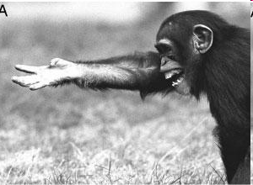
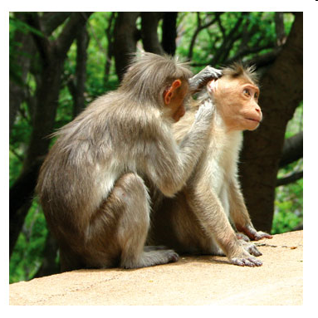
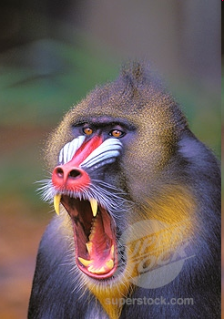
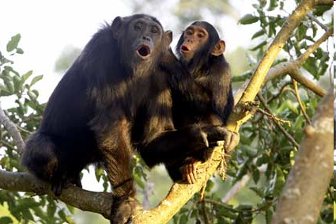
Primate social rituals
As highly social creatures primates have a wealth of social rituals

Slide 12

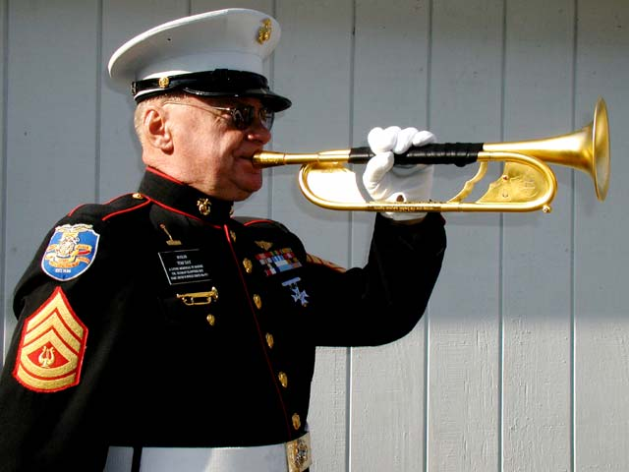
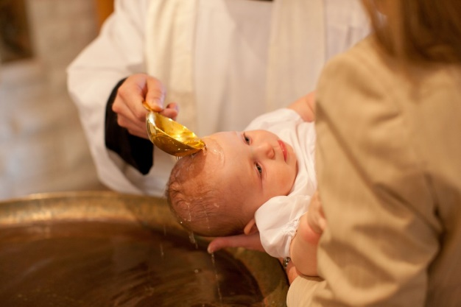
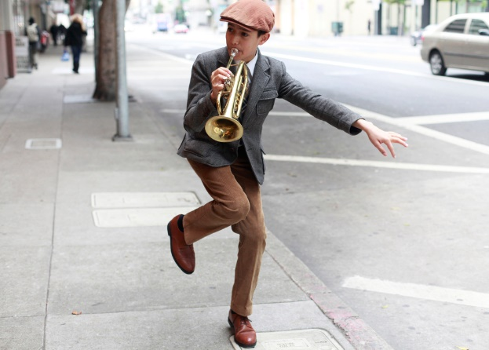
Elements of ritualization
Formalization (exaggerated, stylized)
Repetition (attention-getting)
Invariant sequencing (scripted, rule-governed)
Goal demotion: the act becomes the end
Notes:
Ritualizing actions typically involves bringing isolating automatically executing instrumental actions and bringing them under conscious control. For example, washing a glass or mirror involves repetitive (often circular) hand movements. These actions are usually executed automatically as one attends to the goal (is the glass clean) rather than the hand motions. Ritual cleaning of sacred object focuses attention on the movements themselves which often must be executed in a prescribed fashion (see Boyer & Lienard, 2008). Similar examples might be found in how musical instruments are handled in military bands or how breathing is monitored and controlled in meditative practices. Jai et al, 2010 study shows that these sorts of “lower” level ritualized practices done on regular basis not only engage working memory processes (such as attentional control or emotional regulation) but can produce increases in working memory capacity.

Slide 13

Ritualized behaviors: Honest signals of commitment or self-interested manipulation?
Low cost begging
High cost scrotum grasping
Importance of signal “cost” in function
Notes:
Intended Receivers and Functional Signiﬁcance of Grunt and
Girney Vocalizations in Free-Ranging Female Rhesus Macaques
Jessica C. Whitham*, Melissa S. Gerald & Dario Maestripieri*Ethology 113 (2007) 862–874 ª 2007
Primate Rituals: The Function of Greetings between Male Guinea
Baboons
Jessica C. Whitham & Dario Maestripieri Ethology 109, 847—859 (2003)

Slide 14
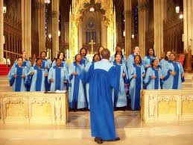
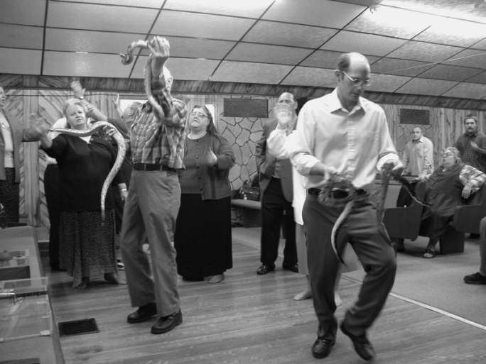
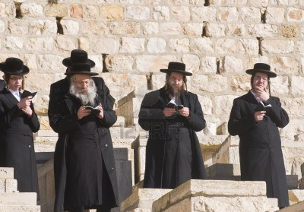
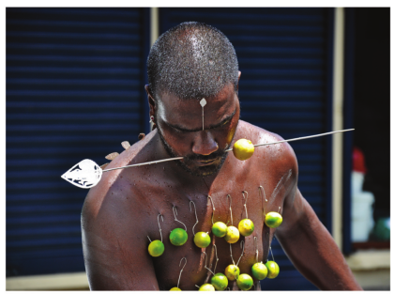
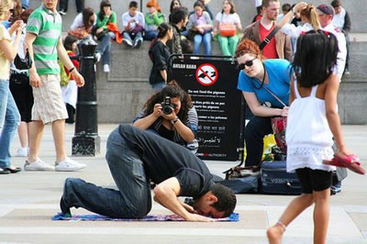
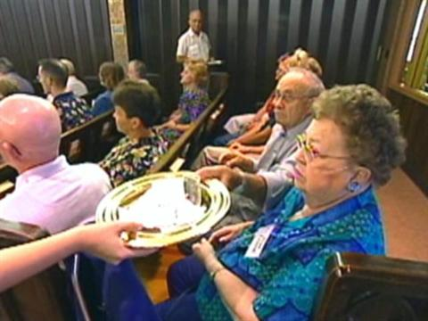
Cost of religious rituals:
Time
Risk
Money
Energy
Public Reputation

Slide 15
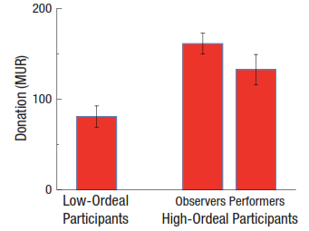
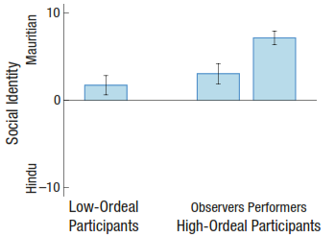
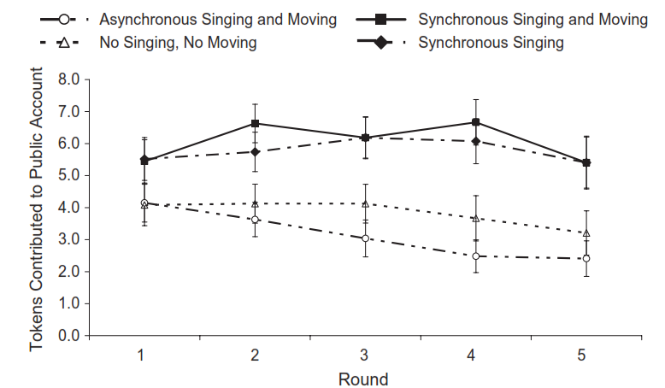
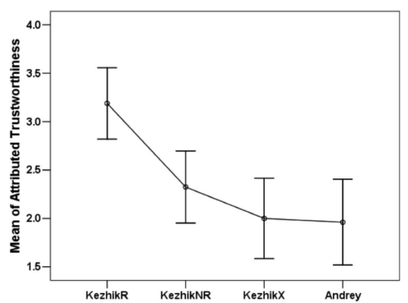
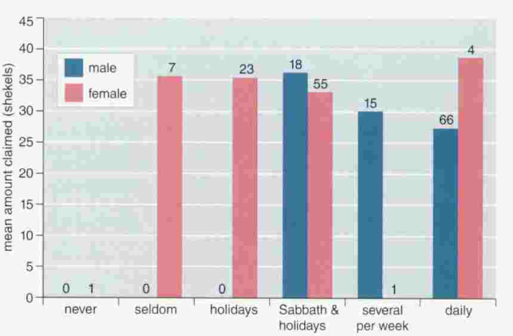
Cost=increased group cohesion
High ordeal participants and witnesses more generous (red middle & right); more emotionally attached to larger social group (blue middle & right)
Those who move in synchrony (dark top line) more generous than those who don’t
Those who leave offerings at ritual cairns (left), more trusted than those who don’t
Public ritual participants more (blue) generous than private
Notes:
Xygalatas, D., Mitkidis, P., Fischer, R., Reddish, P., Skewes, J., Geertz, A. W., Roepstorff, A. & Bulbulia, J. (in press). Extreme Rituals Promote Prosociality. Psychological Science.
Synchrony and Cooperation
Scott S. Wiltermuth and Chip Heath Volume 20—Number 1 2009, Psychological Science
Ritual Behavior and Trust in the Tyva Republic
Author(s): Benjamin Grant Purzycki and Tayana Arakchaa
Source: Current Anthropology, Vol. 54, No. 3 (June 2013), pp. 381-388
Sosis R, Rufﬂe B. In press. Religious ritual
and cooperation: testing for a relationship on
Israeli religious and secular kibbutzim. Curr Anthropol.44 713-722

Slide 16
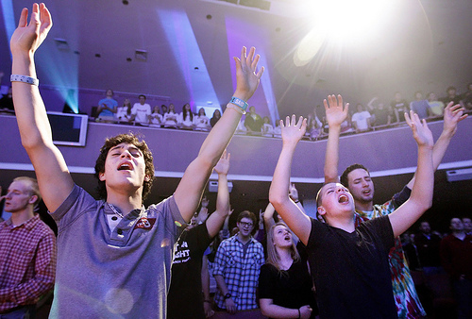
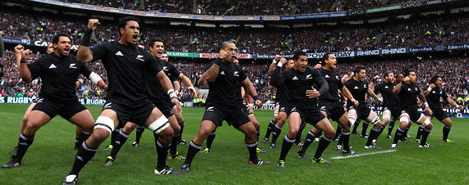
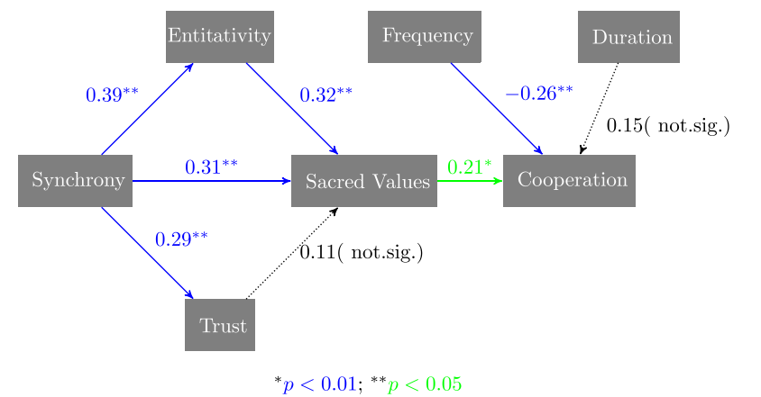
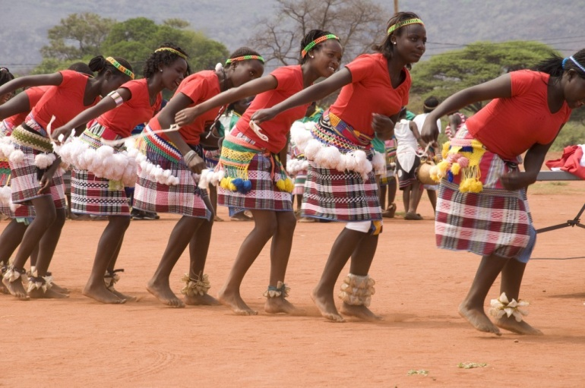
Synchrony and values
All Blacks Rugby ‘Haka’ dance
Venda dance more in good times
Increased synchrony affects:
social bonding, perceived sacredness of values.
Notes:
How Do Rituals Affect Cooperation?
An Experimental Field Study Comparing Nine Ritual Types
Ronald Fischer & Rohan Callander &
Paul Reddish & Joseph Bulbulia
From Hum Nat (2013) 24:115–125
DOI 10.1007/s12110-013-9167-y
Exact synchrony: (Yoga, Buddhist chanting, Kirtan [Hindu devotional singing]).
Complementary synchrony: (Capoeira [Brazilian martial arts]; Brazilian drumming group; choir; Christian church service)
No synchrony: (cross-country running group; social poker).

Slide 17
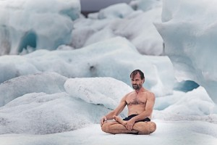
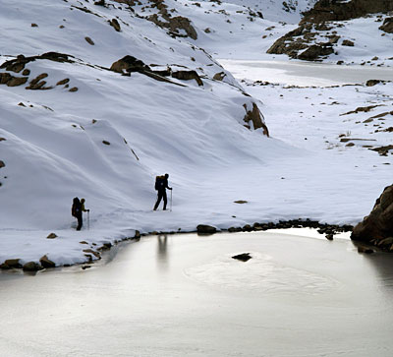
Sustaining power of Ritual
Tummo mediation
Parrado and Canessa: ritual prayer
“Roberto was nearing the end of his strength. My strength was fading, too. Painful cramps had seized my legs making every step an agony … we were walking ourselves to death. … My mind had narrowed until there was no room in my consciousness for anything but the next stride … It was a kind of self-hypnosis, probably brought on by the mesmerizing effects of my rhythmic breathing, the repetitive crunch of my boots on the rocks and snow and the litany of Hail Marys I constantly chanted” (Parrado, MITA P. 211-12)

Slide 18
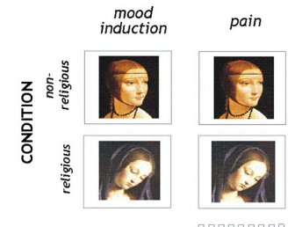
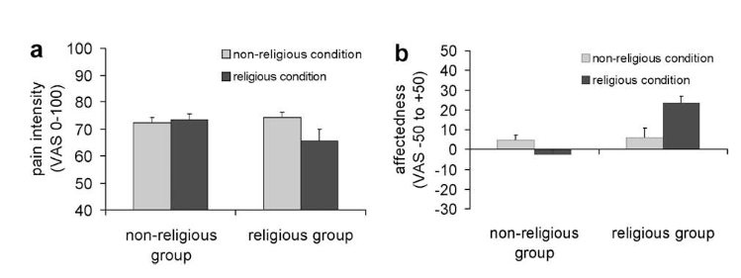
Sustaining power of ritual: Heightened by supernaturalism
Religious and non-religious subjects contemplate female images, rate electric shock pain and positive mood of image
Notes:
Pain 139 (2009) 467–476
An fMRI study measuring analgesia enhanced
by religion as a belief system
Katja Wiech
a,b,
*
, Miguel Farias
c,d
, Guy Kahane
e
, Nicholas Shackel
,
Wiebke Tiede
b
, Irene Tracey
a,b

Slide 19
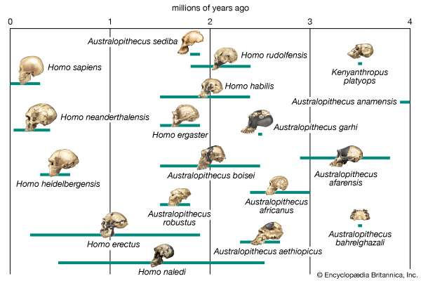
Ritual saves humanity
Human Evolution: Brief Overview
East Africa, drying and cooling 10-5mybp
East apes split from central/west apes
CW apes: gorillas, chimpanzees, bonobos
East apes: Hominins – Homo sapiens

Slide 20
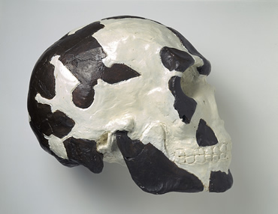


Emergence of Homo sapiens
An ape of no great consequence: Failed excursion into the Levant 100,000 ybp
First anatomically modern humans
Omo Kibish Ethiopia 190,000
Herto 160,000 ybp

Slide 21



Ritual Saves Humanity
First supernatural ritual: Rhino Cave “snake rock”
“Exotic” tools made and destroyed?
70,000 ybp Bottleneck period, near extinction in Africa
Inter-group trade networks, need for trust
Notes:
Coulson, S., Staurset, S., & Walker, N. 2011. Ritualized behavior in the Middle Stone Age: Evidence from Rhino Cave, Tsodilo Hills Botswana. PaleoAnthropology 2011, 18-61.
Rhino cave in Botswana has provided further evidence of ritualized behavior among African Homo sapiens. The cave is located in the highly prominent Tsodilo Hills (see below); yet the cave itself is small, dark and difficult to access, thus requiring great effort to get to. Once there, it was not a hospitable environment for living or working. Despite this, numerous Middle Stone Age tools (indirectly dated to about 70,000 ybp) have been found there. The tools were made of colorful, non-local raw materials. They were carefully manufactured, then burned, intentionally destroyed and abandoned in the cave. Furthermore, one wall of the cave was intentionally modified to enhance its dramatic snake-like appearance. Archaeologists who have studied the site argue that some form of ritual activity – the exact nature of which is unclear – is probably the best explanation for these odd remains.

Slide 22


Ritual Elevates Humanity
Cro-Magnon Neanderthal
Cognitive differences?
Notes:
Rossano, MJ (under review). Costly rituals and the quantitative differences between Homo sapiens and Neanderthals.

Slide 23

Cognitive difference replaced by Ritual Differences
The ritual cost difference between Homo Sapiens and Neanderthals
Both Neanderthals and Homo Sapiens gathered and fashioned beads
Homo sapiens
Ksar’ Akil (Levant) 814
Ucagizli (Turkey) 1098
Fumane (Italy) 900
Neanderthals
Fumane (Italy) 1
Quincay (France) 6
Grotte du Renne (Fr) 36

Slide 24

Red ochre sites
Far more Homo sapiens’ sites, far more sites with high volume compared to Neanderthals. From: Rossano (2015)

Slide 25



Ritual Burial
Burials:
Sungir (Hss)
Chapelle-aux-Saints

Slide 26





Cave rituals
Upper Paleolithic Cave Ventures

Slide 27

Neanderthal rituals
Bruniquel Cave “bear cult” rituals
Notes:
Hayden, B. 2012. Neanderthal social structure. Oxford Journal of Archaeology 31, 1–26.
Walker, M. J. et al. 2012. The excavation of buried articulated Neanderthal skeletons at Sima de las Palomas (Murcia SE Spain). Quaternary International 259, 7-21.

Slide 28
Cave rituals
Rhino Cave, Botswana, Hss
Bruniquel Cave “bear cult” rituals, Neanderthals
Notes:
Hayden, B. 2012. Neanderthal social structure. Oxford Journal of Archaeology 31, 1–26.
Walker, M. J. et al. 2012. The excavation of buried articulated Neanderthal skeletons at Sima de las Palomas (Murcia SE Spain). Quaternary International 259, 7-21.

Slide 29





Ritual: Robbing nature of the last word

